Slide 1



Body Language and its Positive Impact on
Our Professional Growth
Presented By :-
Ayushi Sinha
Aditya Shah
Deepti Meher
Mayank Kumar
Shyara Selina
Piyush Thakur
16-Aug-24
1

Slide 2
Introduction :-
Body language is a type of communication in which physical behaviors, as opposed to
words, are used to express or convey information.
“What you do speaks so loud that I cannot hear what you say”- Ralph Waldo Emerson
“The body never lies” - Martha Graham
16-Aug-24
2

Slide 3
Elements of Body Language :-
Gestures - Hand movements and their meanings
Posture - Open vs closed posture and its implications
Eye Contact - Establishing trust and confidence
16-Aug-24
3

Slide 4



Gestures :-
Thumbs-up
Pointing
Waving
They can emphasize points, indicate direction, or convey specific meanings.
16-Aug-24
4

Slide 5


Posture :-
Standing Confidence
Sitting Confidence
It can indicate confidence, openness or defensiveness.
16-Aug-24
5

Slide 6
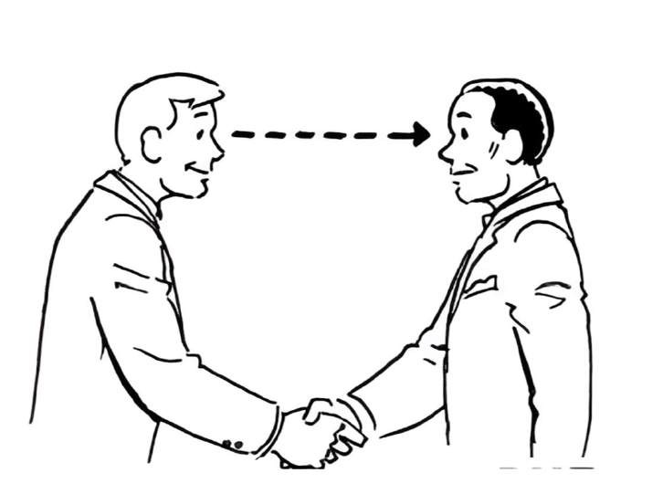
Eye Contact :-
It establishes connection and trust during interactions.
6

Slide 7
Impact on Professional Growth :-
First Impressions :-
How body language influences initial perceptions
Communication Effectiveness :-
Enhancing verbal communication with non-verbal cues
Leadership and Influence :-
Using body language to command respect and authority

Slide 8
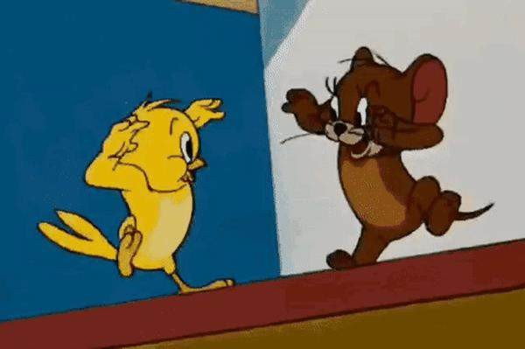
A. Building confidence and credibility :-
Confident posture
Firm handshake
Steady eye contact
B. Improving interpersonal relationships :-
Open body language
Approachable demeanour
Positive Facial Expressions

Slide 9
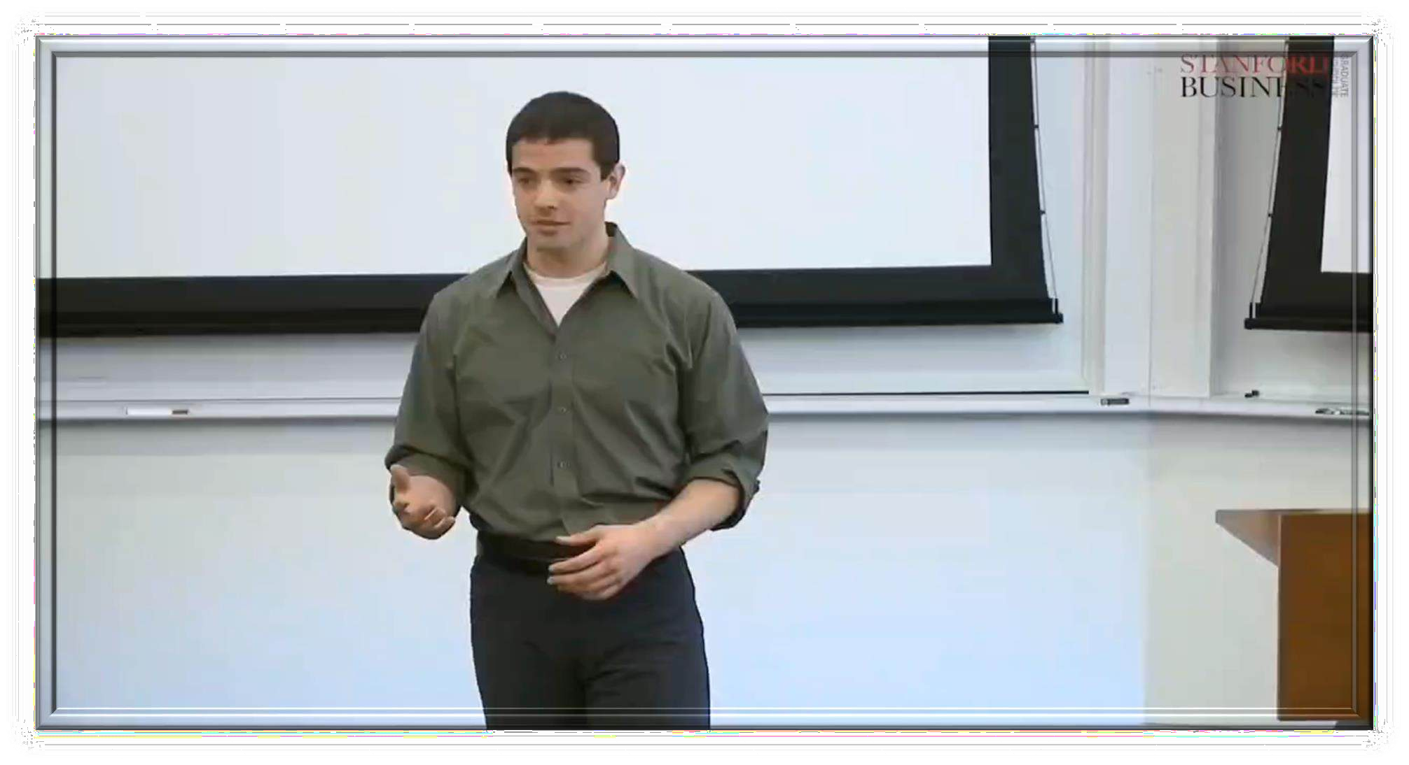
Don'ts of Body Language During a Presentation :-

Slide 10
Tips for Improving Body Language :-
Self-Awareness :-
Being conscious of your own body language
Observing Others :-
Learning from effective communicators
Practice and Feedback :-
Continuously improving through practice and seeking feedback

Slide 11
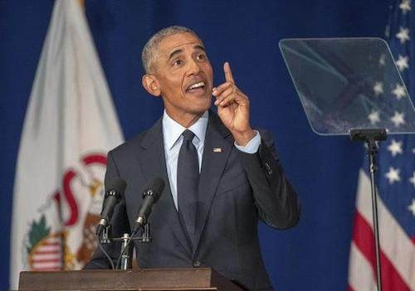
Case Study :-
Barack Obama :-
Barack Obama is known for his confident and open body language. During speeches, he often uses hand gestures to emphasize key points and maintains steady eye contact with his audience.
Impact :-
His body language helps convey confidence, approachability, and trustworthiness, making his messages more compelling and engaging.

Slide 12
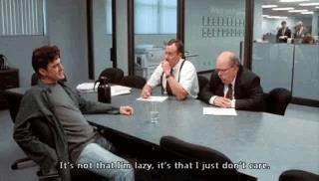
Job Interview Scenario :-
Imagine two candidates in a job interview.
Candidate A maintains good posture, makes eye contact, and uses positive facial expressions. Candidate B slouches, avoids eye contact, and has a neutral facial expression.
Outcome :- Candidate A is more likely to make a positive impression on the interviewer because their body language shows confidence and enthusiasm.
Candidate B's poor body language might make them seem disinterested or unprepared.
16-Aug-24
12

Slide 13
Conclusion :-
Body language is a powerful communication tool.
Mastering body language boosts professional success.
Conscious body language practice is essential..

Slide 14




